Slide 1

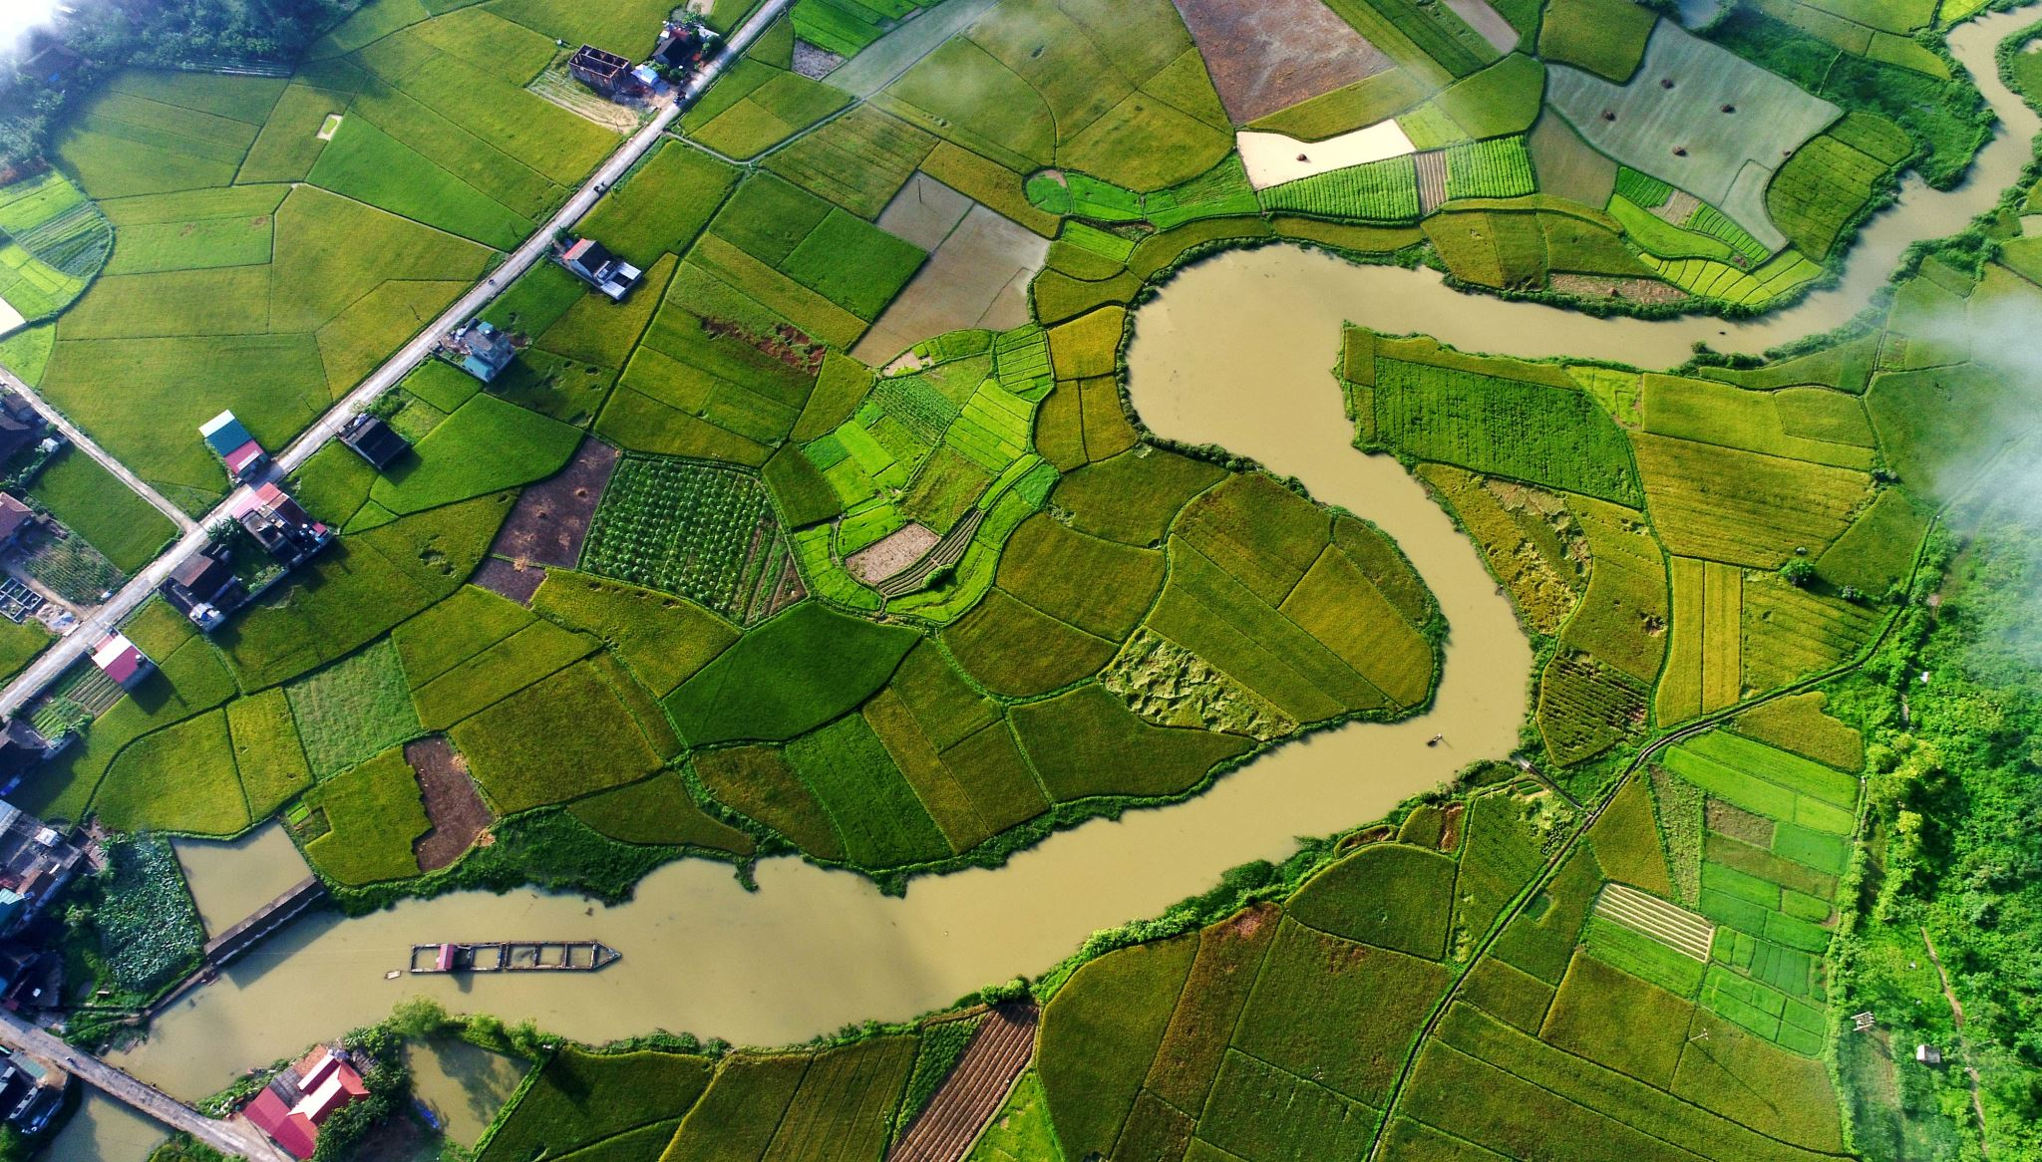

Image-based Plant Disease Detection
Aditya Rane 20070123002
Arzoo Lakhani 20070123011
Balajee Srinivasan 20070123095
Manasvini Vaya 20070123065
Guide Name:
Prof. Kunal Shejul

Slide 2
Agenda
Introduction
Literature Review
Methodology
Block Diagram
Experimentation and Results
Costing of Project
Strength and Weakness
Plan of work
Conclusion and Future Scope
References

Slide 3
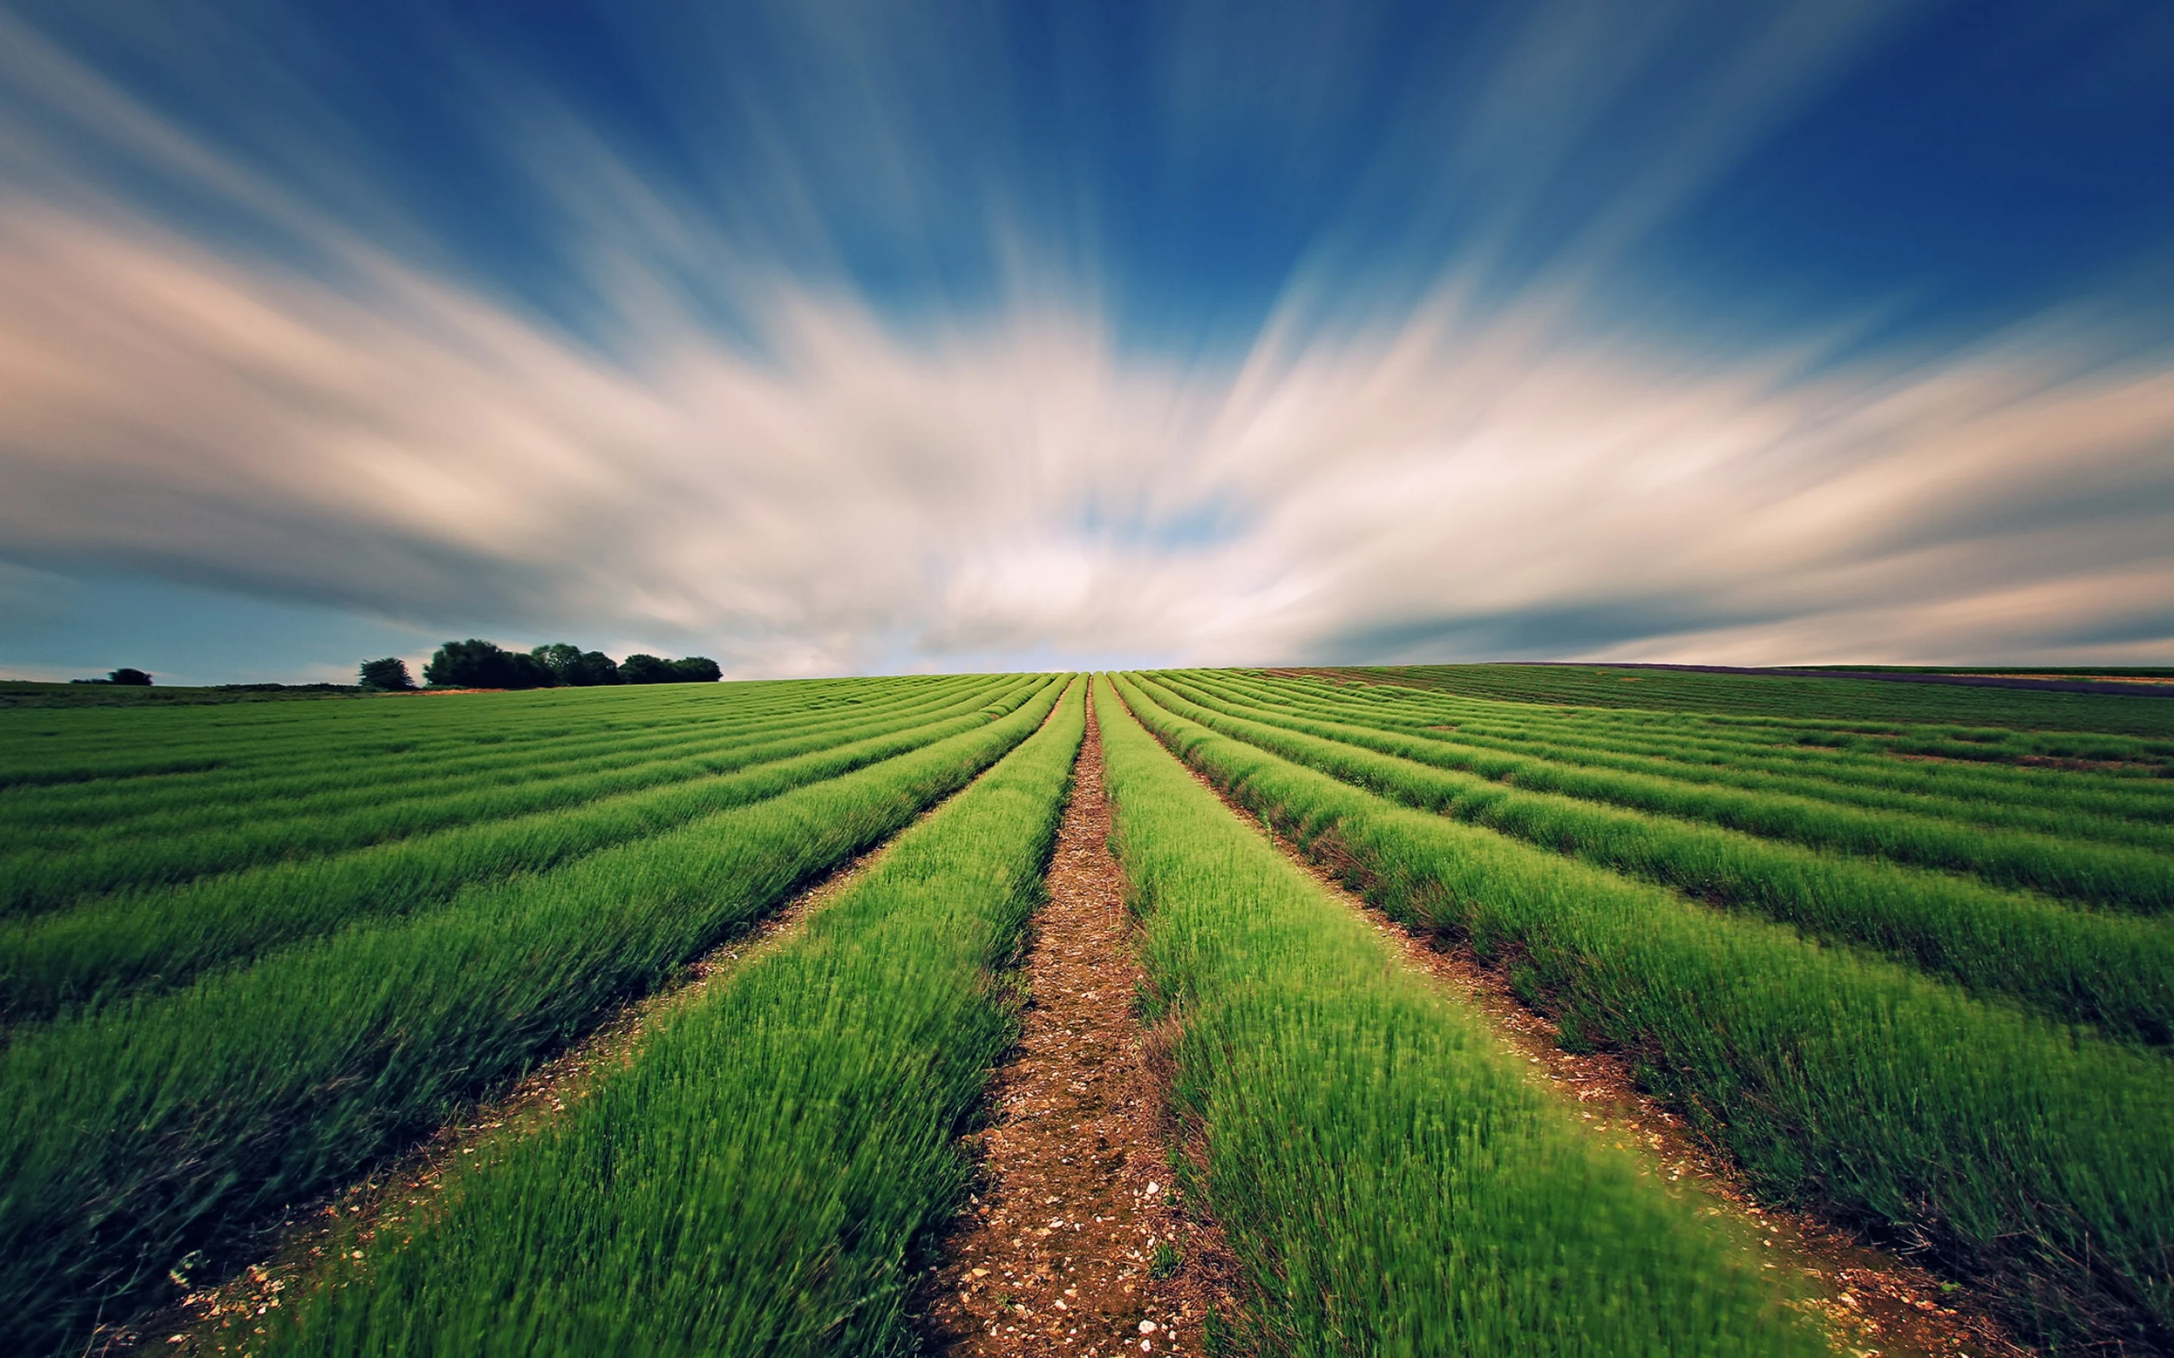
INTRODUCTION
INTRODUCTION

Slide 4
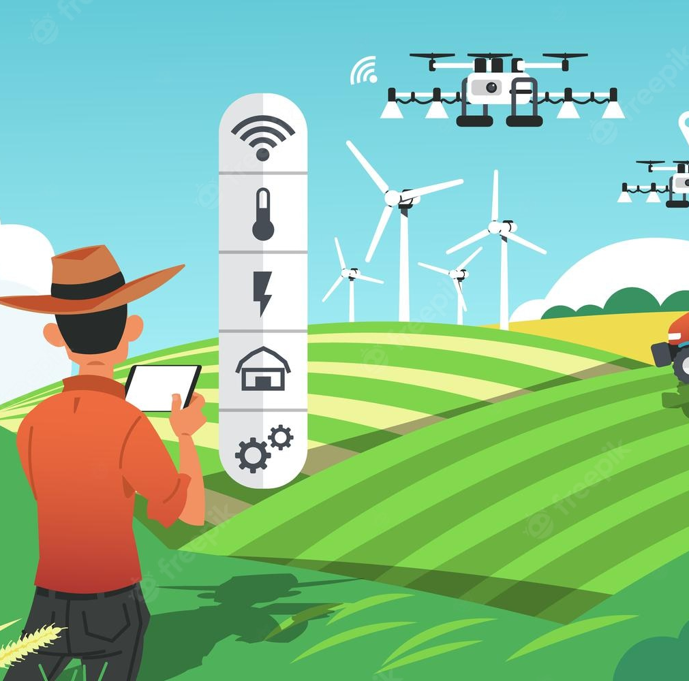
Developed Technologies have provided the ability to produce sufficient food to meet the demand of society. But still, the safety of the food or crops remained unattained. Factors like not taking care of plants can cause the crop to fall . And Farmers cannot take care the entire field by themself which also can lead to unhealthy crops .
So , for our project, we will add the raspberry pi cam and with the help of computer vision , we will be applying it on our Quadcopter, and will make it a live image processing Quadcopter , so that we can use it to identity the unhealthy corps at the early stage. Therefore, it can be used as a surveillance for the crop field for the farmers .
Problem Statement: Make an efficient plant-disease detecting system that can alert famers before the damage is unrepairable.

Slide 5
LITERATURE REVIEW
LITERATURE REVIEW

Slide 6
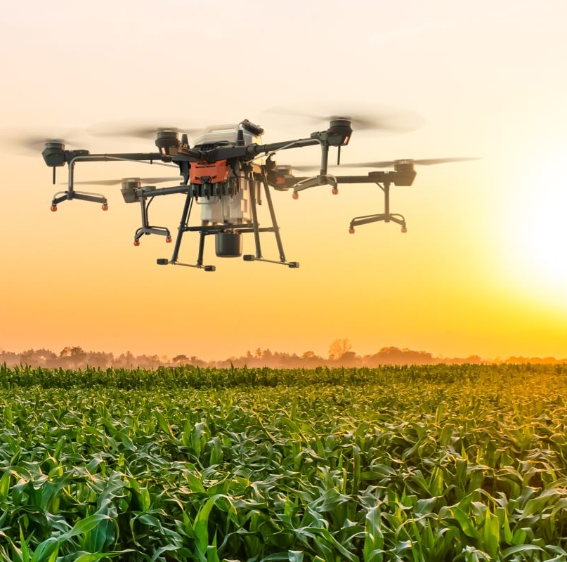
This literature survey includes the ongoing work in the field of computer vision for image-based plant detection. The objective was to examine several approaches to plant disease diagnosis using digital image processing. A comparative study was conducted employing several image processing techniques for the purpose of identifying plant diseases. Numerous studies use the image's standard deviation, mean, entropy, homogeneity, energy, and other characteristics to identify diseases.
Recent advances in computer vision enabled by deep learning have made smartphone-assisted disease detection conceivable. The underlying pre-set properties had a significant impact on the effectiveness of the approaches, such as SIFT, HoG, and SURF. The feature engineering process itself is challenging and complex, and it must be repeated whenever the current circumstance or the dataset it is associated with considerable changes. This problem occurs in all current attempts to detect plant diseases using computer vision since they rely on manually developed features, picture augmentation techniques, and a range of other complex and time-consuming procedures.

Slide 7
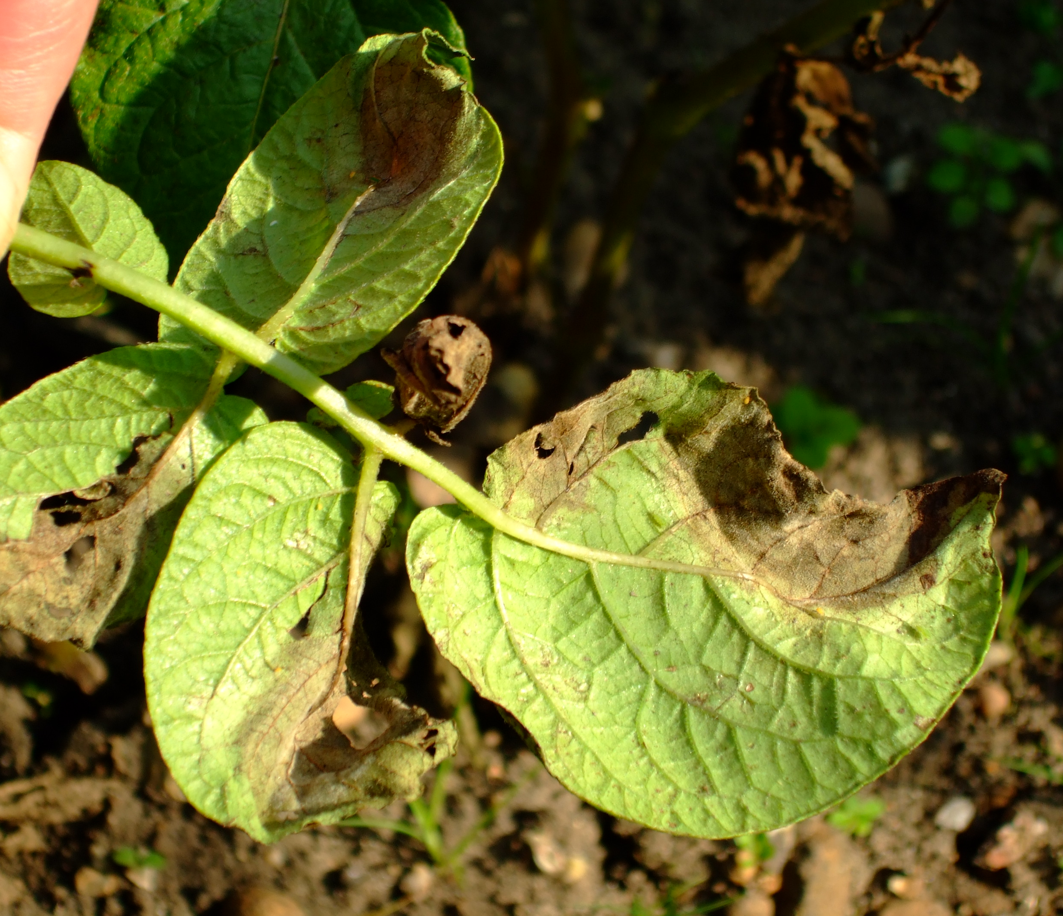
A research was conducted and the work done by Sumit S Thote and Prof.Mrs Snehal A proposed a smart irrigation system in which the camera is attached to the embedded system where it captures the image and process it, then it displays the result where the result obtained here is less accurate in identifying the disease.
Image processing professionals used MATLAB to extract variables including contrast, correlation, energy, homogeneity, mean, standard deviation, and entropy in order to identify the infection by looking at the image. They first establish a database using these attributes, and then they use this database to identify the diseases.
The pixel values and neighbouring pixel values are the primary factors taken into account while segmenting an image. The segmentation of the image is completed after the masking of the image, which is accomplished by comparing the pixel values with those of the surrounding pixels. In certain articles, image segmentation is carried out using K means-based segmentation of the damaged area, feature extraction from the defective portion, and disease classification based on an artificial neural network. The severity of the disease is then determined by taking into account the number of pixels that depict the effects of the virus on the fruit or leaf.

Slide 8
METHADOLOGY

Slide 9



Engineering systems, variables, and parameters to solve this problem statement:
Use computer vision to extract required information about plant health from given data set.
Use Convolutional Neural Networks(CNN) to process the pixel data and classify the data set.
Use Tensorflow to create the convolutional neural network.
Use React Js and React Native for front end development.
Raspberry pi camera and Raspberry microcontroller will fulfill the hardware requirements for computer vision.

Slide 10
BLOCK DIAGRAM
&
FLOWCHART

Slide 11
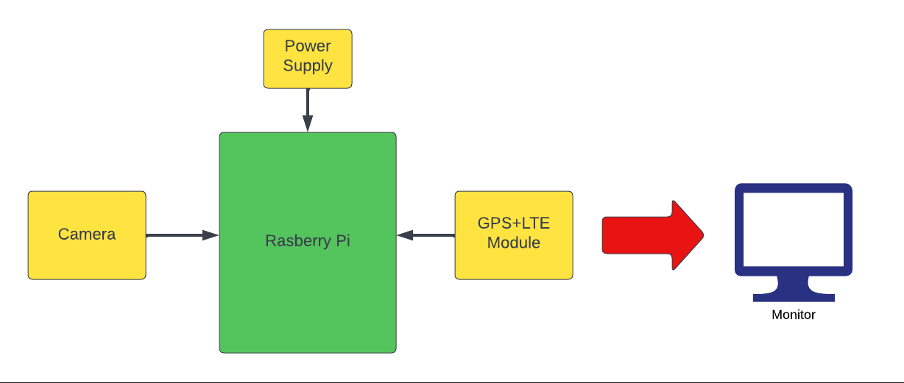
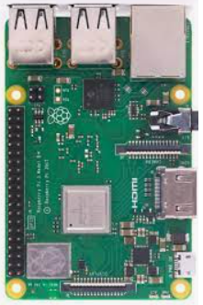
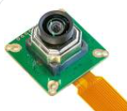
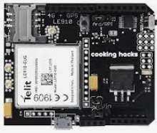

Slide 12
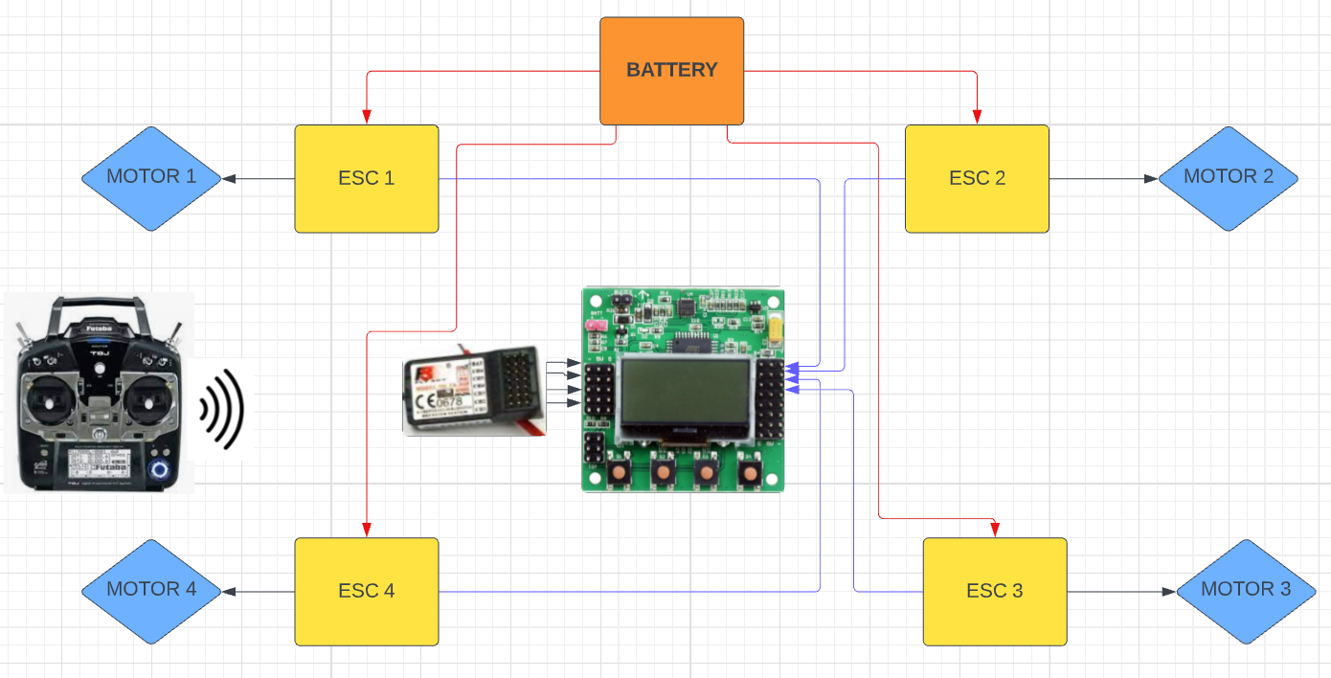

Slide 13
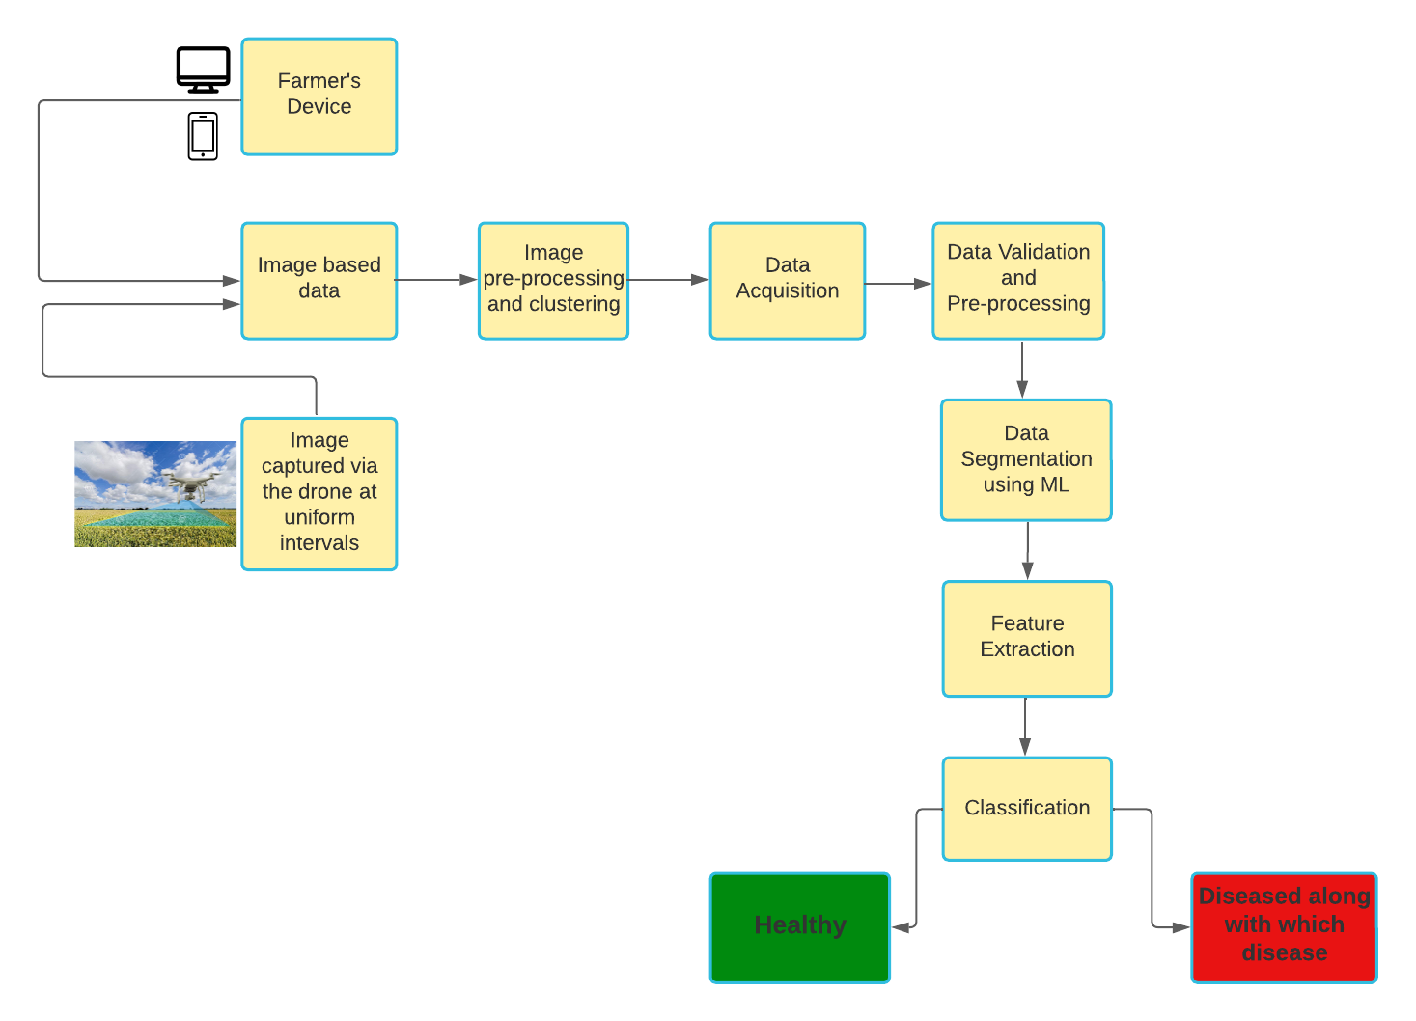
DETECTION FLOWCHART

Slide 14
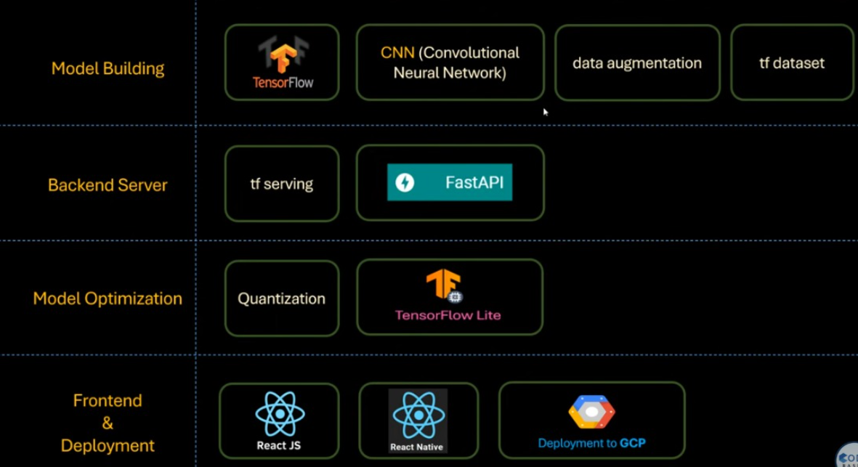

Slide 15
Hardware and Software Requirement with Costing of the Project

Slide 16
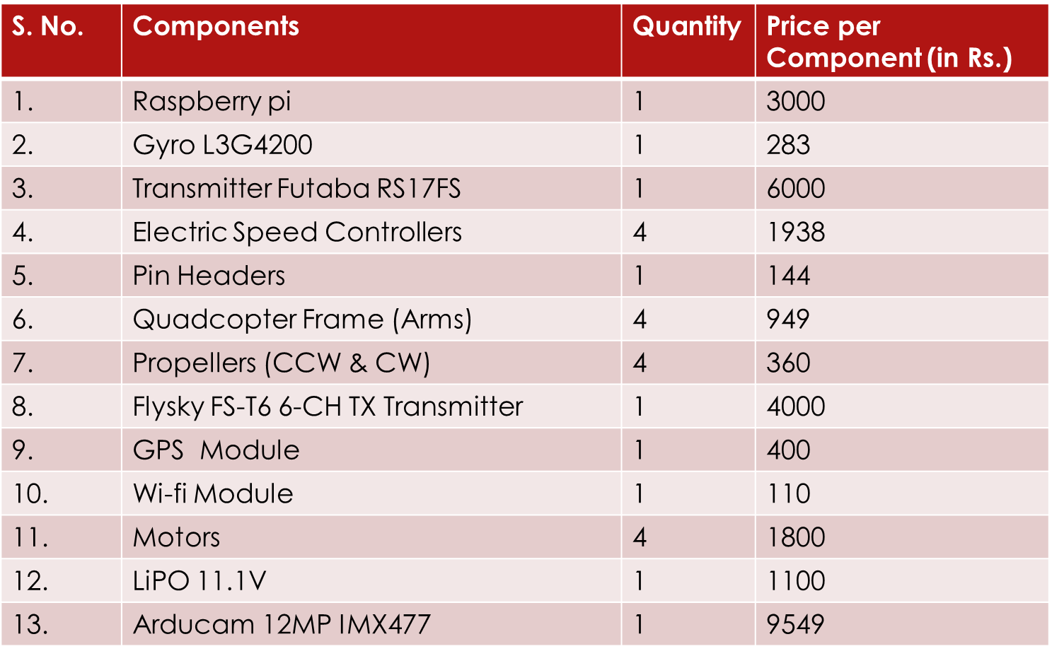

Slide 17
Experimentation and Results

Slide 18
DATASET USED | PlantVillage by Arjun Tejaswi on Kaggle
ML TECHNIQUE | Deep CNN and image processing
EVALUATION MEASURES | Training Accuracy, Training Loss, Validation Accuracy, Validation Loss, Model Size
DATA SET USED | The dataset is created by PlantVillage and can be found in Kaggle
TAKEAWAY/KEYPOINTS | After enough experimentation, the models have shown the best results for batch size of 32, learning rate of 0.001, etc. The models are trained for 50 epochs.
ADVANTAGES AND APPLICATIONS | The model has been trained using a large public dataset of plant images and has attained an accuracy of around 98%.
LIMITATIONS | Does not give suggestions of fertilizers based on detected disease

Slide 19
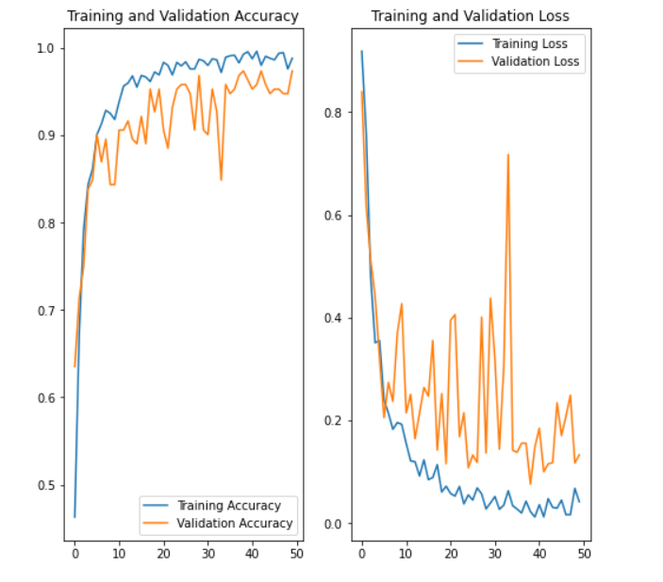
Graph of training and validation accuracy

Slide 20
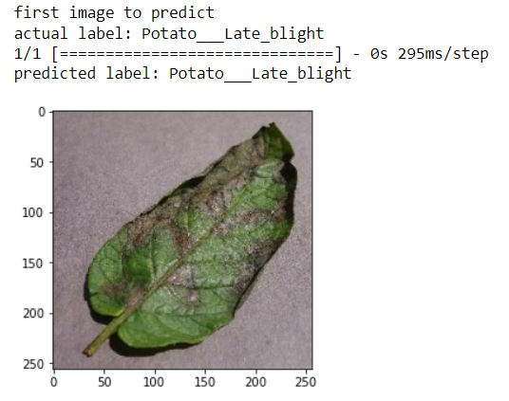
Testing of a single plant leaf

Slide 21
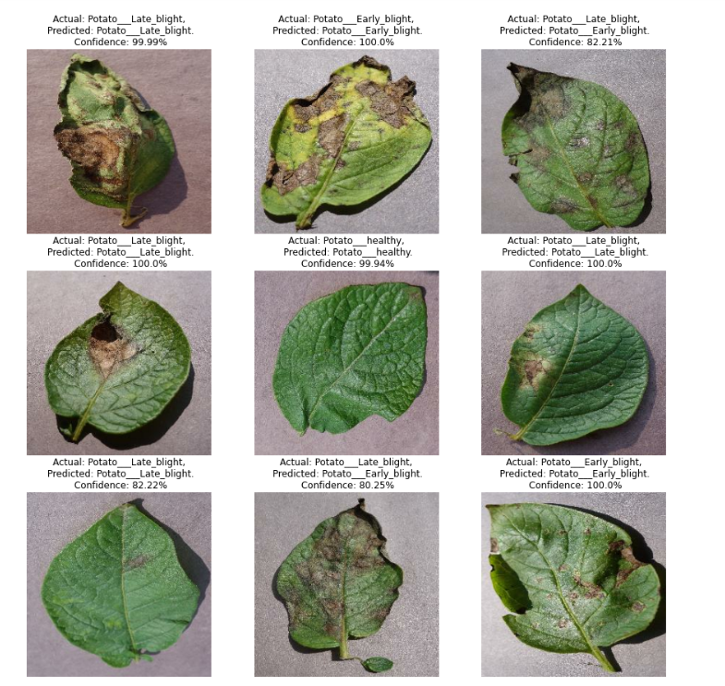
Final Output of Detection of Plant
Leave Diseases with Confidence
Percentage :

Slide 22
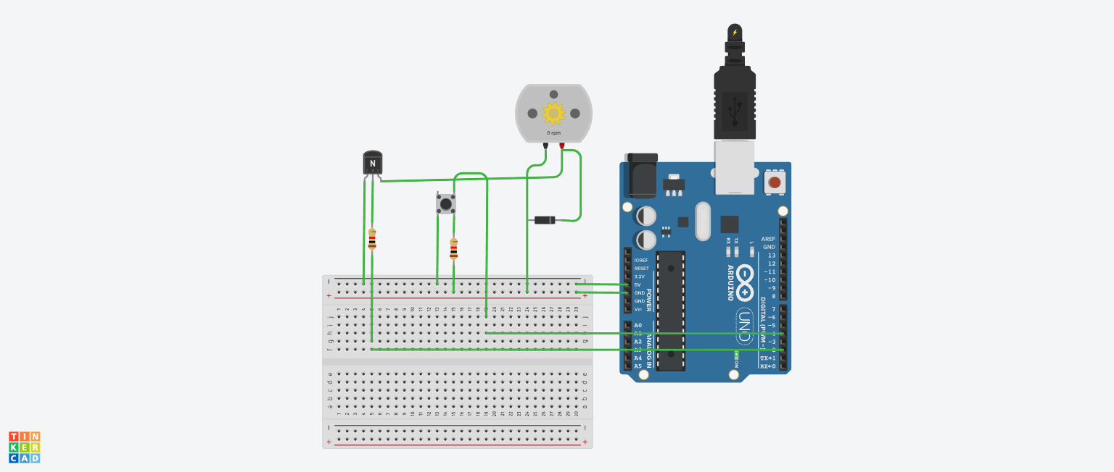
SPRINKLER
TINKERCAD MODEL OF THE SPRINKLER
One of the button on the drone controller can be linked to the 7th channel of the receiver. The 7th channel can then be connected to the Arduino. When the button is pressed the DC pump starts and the pesticide is pressed and when it is pressed again the spraying stops.

Slide 23
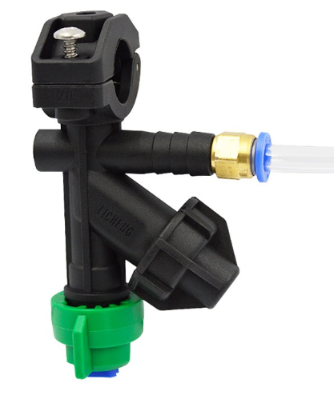
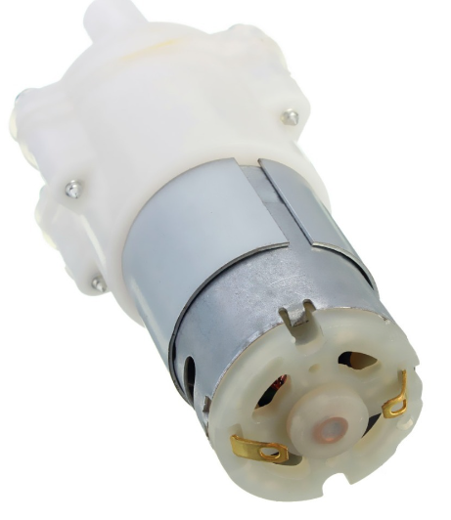
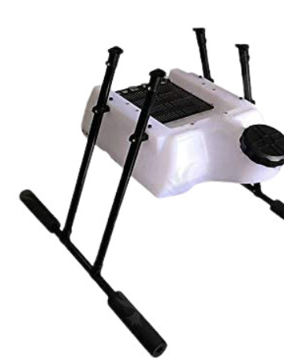
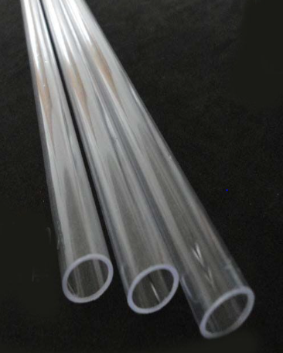
Components used for sprinkler SYSTEM
Rotating sprinkler nozzle.
Water tank (3-D printed)
Transparent Polycarbonate tube.
12V DC Pump
Arduino

Slide 24
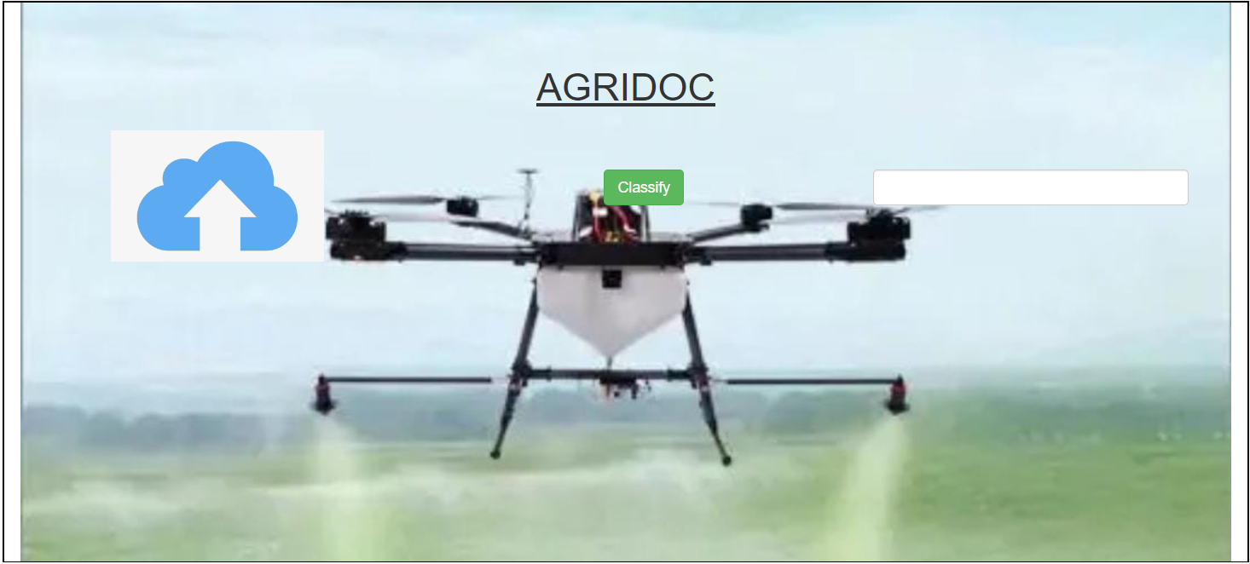
Website
Front End of our Website
Image File Uploader :-
This is used to insert our image to be checked
Classify Button :-
Here we created a Button named Classify which classifies the uploaded image and gives the calculated output in the text box
TextBox :-
In the TextBox it will display whether the uploaded photo of a plant is Healthy or not

Slide 25
Conclusion
We have understood what computer vision is and how it is used for image-based plant detection.
We have understood the working of CNN (Convolutional Neural Network) for how to process pixel data and classify in data set
How to create a CNN with TensorFlow
We have made a training model for detecting diseases in potato crops with the help of CNN through Tensor Flow and available dataset.
Raspberry pi camera and raspberry microcontroller
Structure and Configuration of Drone
Front design of website using HTML and CSS.
Designing a sprinkler system.
Future Scope -
With the added help of Computer vision and Raspberry pi cam we can identify the unhealthy crops but our goal is to help the farmers to the fullest so we will add fertilizer with tank and nozzle so that it can not only identity but also gives instant solution on that spot by fertilizing the crops

Slide 26
References
https://www.frontiersin.org/articles/10.3389/fpls.2016.01419/full
https://www.sciencedirect.com/science/article/pii/S2666285X22000218#sec0003
https://www.coursera.org/learn/introduction-computer-vision-watson-opencv/home/week/2
https://www.run.ai/guides/deep-learning-for-computer-vision/tensorflow-cnn

